Slide 1
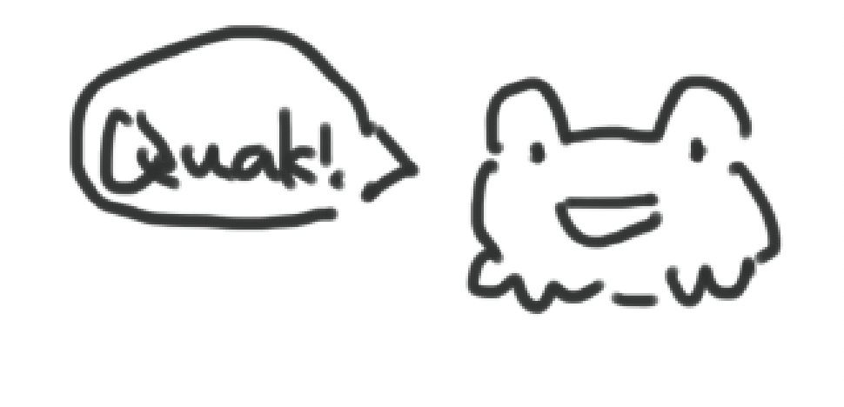
— LT2216 Game Project
“Frog”
Tianyi Geng

Slide 2
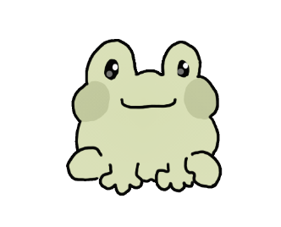
Introduction to “Frog”
Sentence
A Game for learning a new language (“English”, for now)
Word
“What does it do?”
Topic
Grammar
You will now “Teach” instead of “Learn”!!
…
- - In the vast wild (…or anywhere), YOU met “Frog”.
- - What is Frog? What does Frog do? … You have no clue.
- - The ONLY thing you know is that … “Frog wants to learn your language.”

Slide 3
Frameworks: Xstate, SpeechState
Language: HTML, CSS, Javascript
Resourses: Azure Language resources (speech recognition, natural language understanding…)
Technicalities

Slide 4
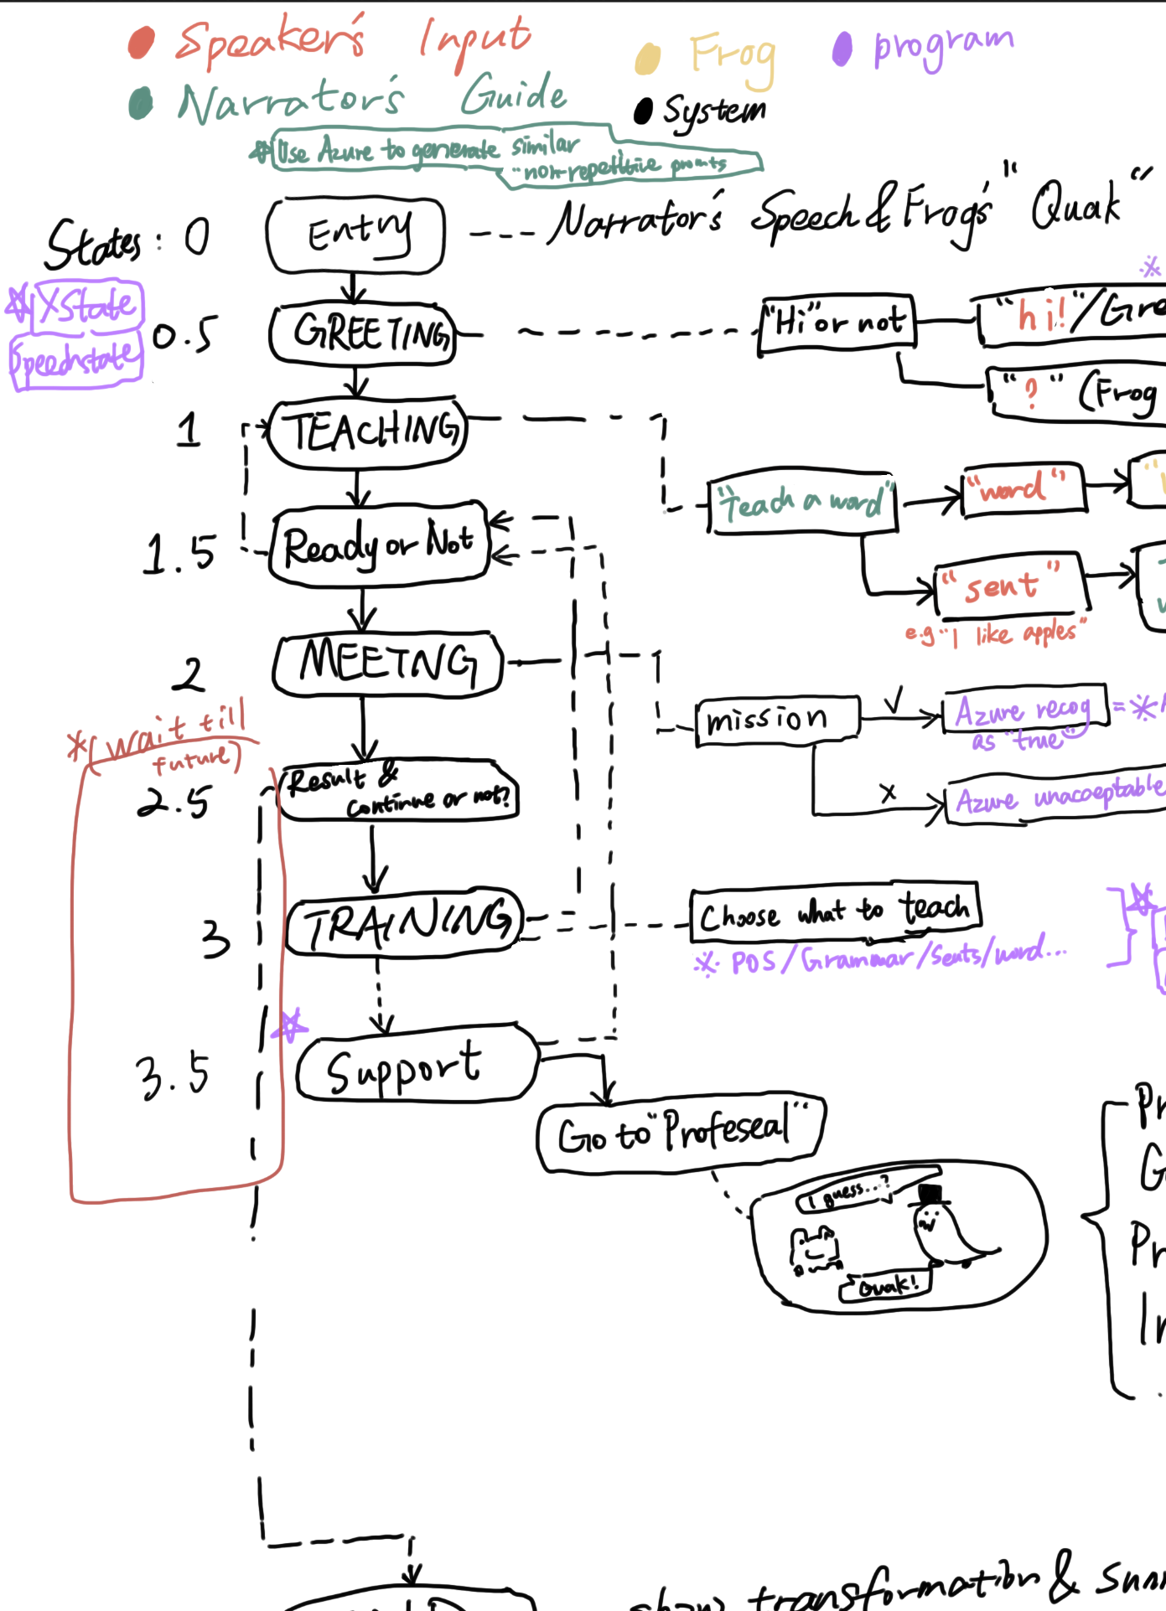


Challenges
“There are MANY…!!”
(Technical) Understanding how Javascript, “Xstate” and “SpeechState” work
There are a lot of concepts & details to learn and read for beginners…!
e.g.”Entry”&”Exit” only act once; “entry action can only be activated again if entering the child state from parent state”, …etc.)
You might have entered the state before finishing the last action…?
i.e. While the speech is not finished, your machine has already entered next stage since the “send event” action is done! This is kind of anti-intuitive (for me).
(GameDesign) What am I trying to do?
Game flow design — “First what, then what, and what happens after that?”
Gamification — “How do I make a language game fun?”

Slide 5
Related to course contents
Course Contents
e.g. Xstate, Speechstate Walkthrough, Lab practice
Is StateCharts Useful?
Frameworks/Tools
My Development
Peer reviews
Concerns?

Slide 6
More Teaching… And most importantly… MORE FUN.
The Future—“Where will Frog go?”

Slide 7

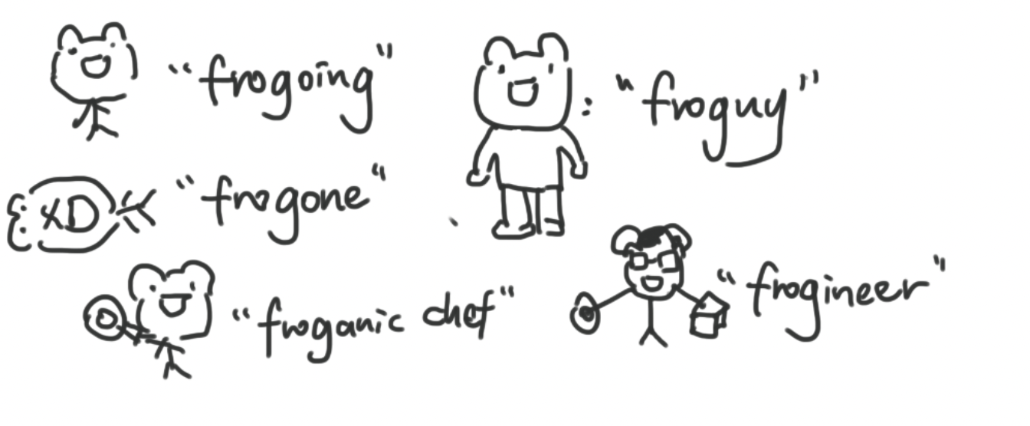
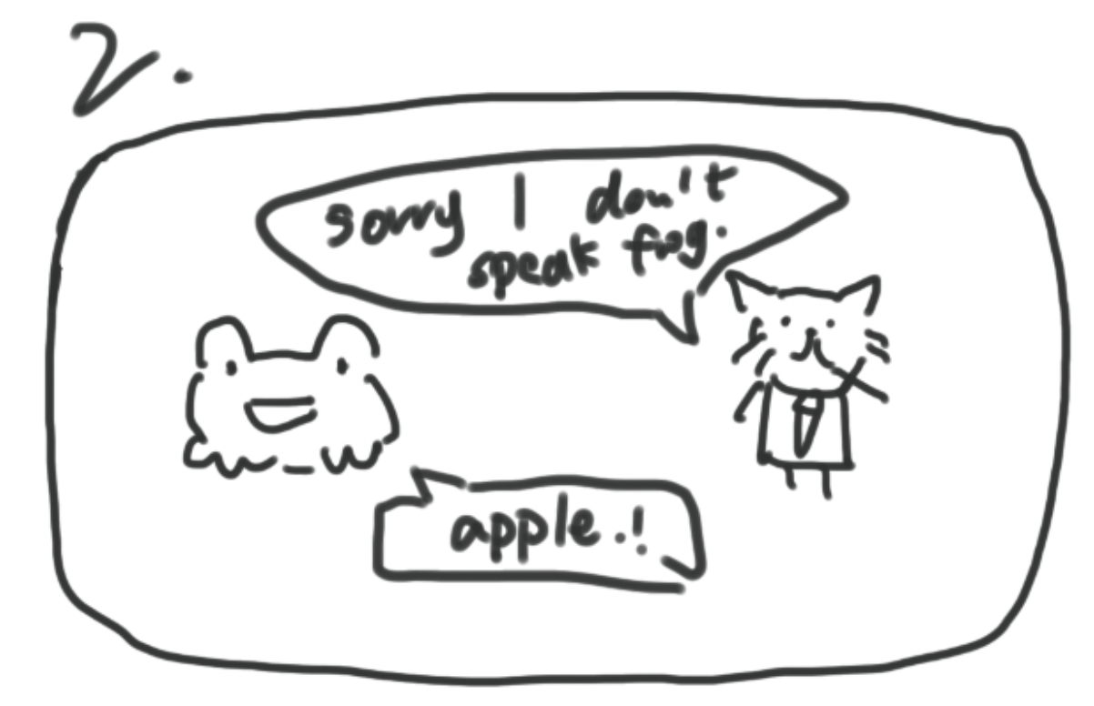
Future Plans
“Aha!..I see you need grammar help.”
Different voice for characters!
More Stages!
(Now) 1.Greeting 2.Teaching 3. Meeting 4.Results
(Future) 5.Provide Help 6.Friends&Stories 7.Mini Games 8.Cute features
Provide Help
“Smarter Input” (analyse entities and store to generate new sentences…etc.)
Teaching
Meeting
(More tasks, characters, stories?)
Frog Transform
Frog Grow
Evaluation/Results

Slide 8
Thanks!
Please keep this slide for attribution

